Slide 1
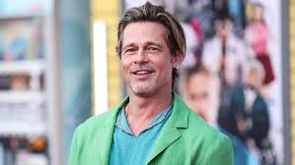
Celebrity Face Recognition
By Ryan French, Sukanya Joshi, and Luisa Silva

Slide 2
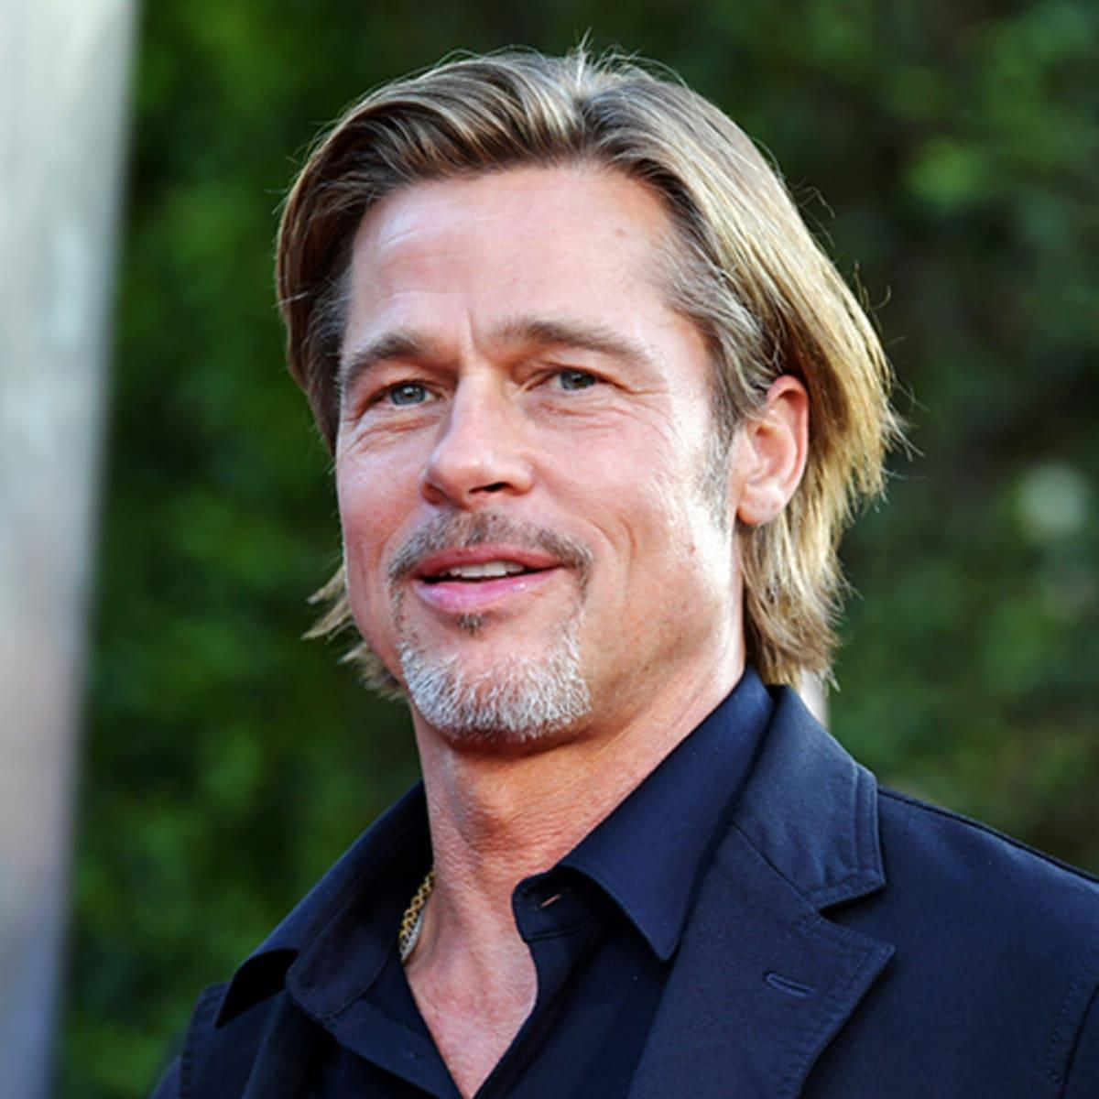
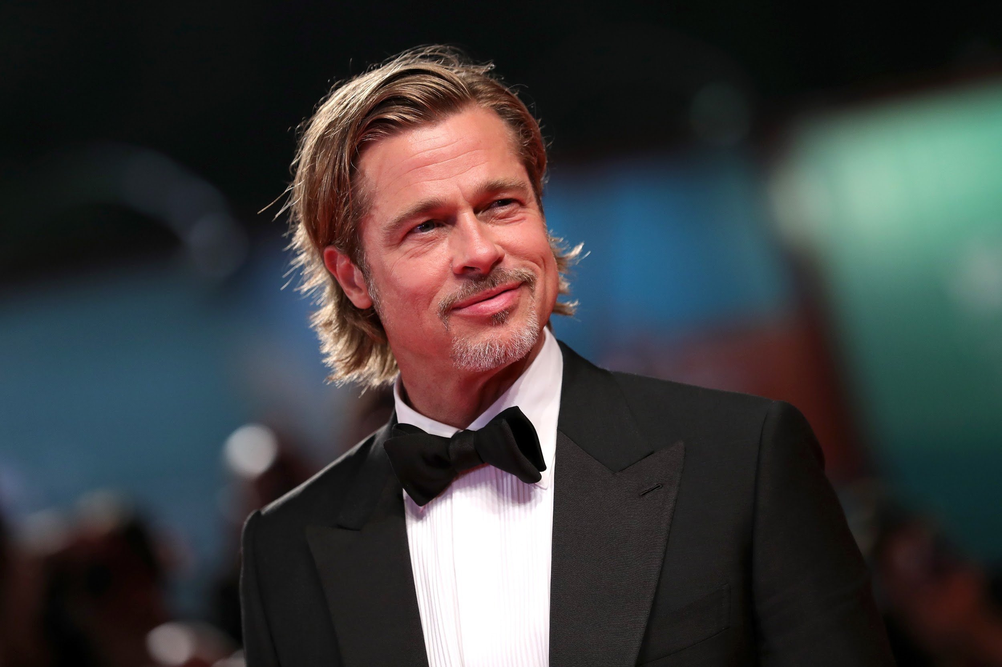
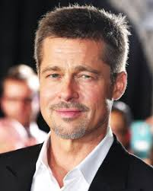
Introduction & Background
We are huge fans of Brad Pitt!
Wouldn’t it be super cool to detect Brad Pitt in a video filled with numerous people?

Slide 3
Objectives & Methodology
Objective:
Recognize Brad Pitt’s face amongst a group of individuals in a video
Draw a bounding box around the face with the highest probability of that being Brad Pitt
Methods:
Utilize a pre-trained VGG-16 model to extract features from images of Brad Pitt
Train a neural network on extracted features with logistic regression fully connected layer
Use OpenCV to recognize faces in a video and apply our model to predict how likely that face is Brad Pitt’s or not.

Slide 4
Training Dataset
Used OpenCV to create the images out of the videos
Total Dataset = 1800 Images
Total images of Brad Pitt = 500 (video) + 400 (non-video) = 900
Total images of non-Brad-Pitt = 900(non-video) = 900
900
Non-Brad
PubFig
Images
500
Brad
Video
Images
400
Brad PubFig Images

Slide 5

VGG Model
Extracted features from raw images with pretrained VGG-16 model
Replaced with linear model
Notes:
Input shape: 244x244x3
Output shape: 7x7x512

Slide 6
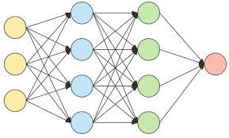
Linear Model
Input: flattened vector of 1x25800 features extracted from VGG-16
3 linear layers of Scaled Exponential Linear Unit activation
1 linear layer of sigmoid activation
Output: 1x1 Pr[Brad]
Layer (activation) Output Shape Param #
============================================
input (1, 25088)
linear_0 (SELU) (1, 1000) 25089000
linear_1 (SELU) (1, 500) 500500
linear_2 (SELU) (1, 50) 25050
linear_3 (SIGMOID) (1, 1) 51
============================================

Slide 7
Face Detection
Create bounding box on Brad Pitt’s face throughout the video
For every video frame:
Use OpenCV to recognize all faces in the frame
Iterate through all faces and input them into our model
For each face we’ll get a probability of how likely it is Brad Pitt
We add bounding box to face with highest probability of all
Save output video as mp4

Slide 8

Demo

Slide 9
Results
Videos | # of Frames | Correctly Classified | % Correct
Just Brad 1 | 376 | 259 | 68.8%
Just Brad 2 | 325 | 307 | 94.4%
Brad in Friends | 278 | 252 | 90.6%
Group at Table | 270 | 237 | 87.7%

Slide 10
Challenges
Function VideoWriter_fourcc was corrupting our output video because we were specifying the wrong output format
Used the resize function from PIL package as Cv2.resize function was not properly resizing our image
Results were better when Brad was mostly facing the camera as opposed to looking sideways

Slide 11
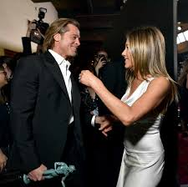
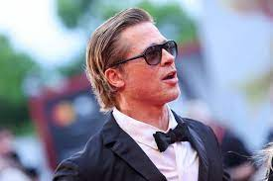
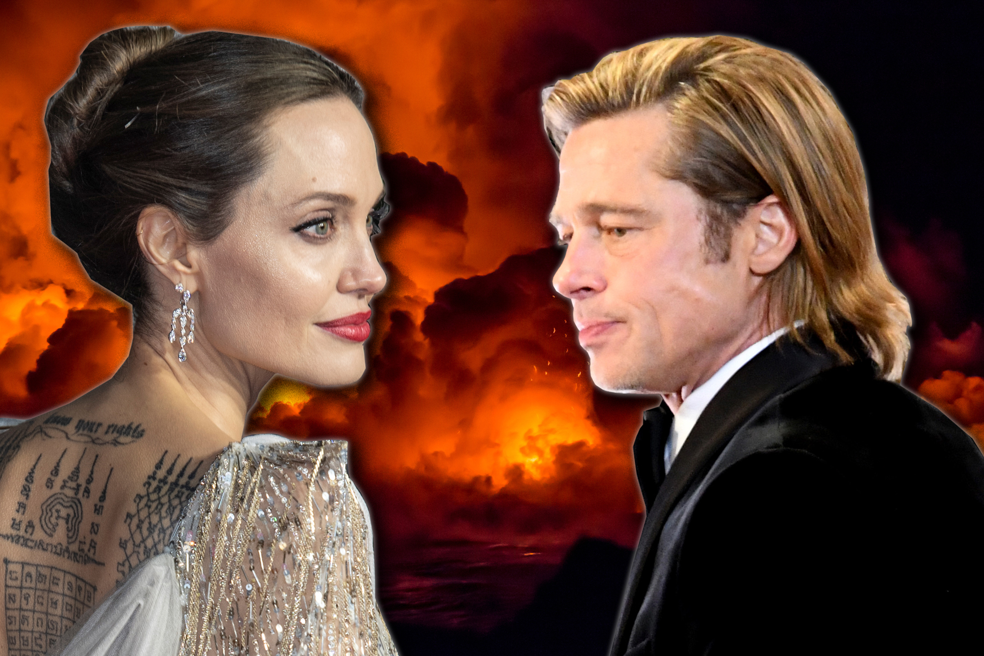
Next Steps / Future Directions
Extend our model to recognize multiple celebrities
Improve our model’s capability for recognition by adding images to the dataset where our celebrity (Brad Pitt) is seen from more diverse angles.

Slide 12
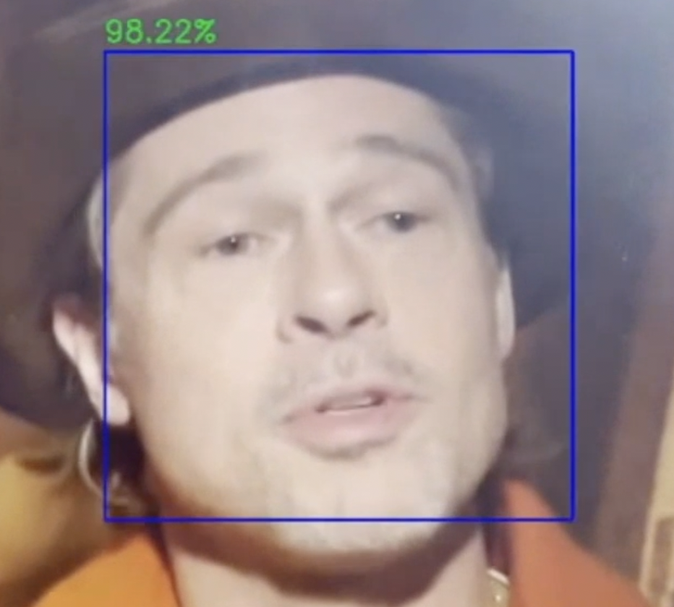
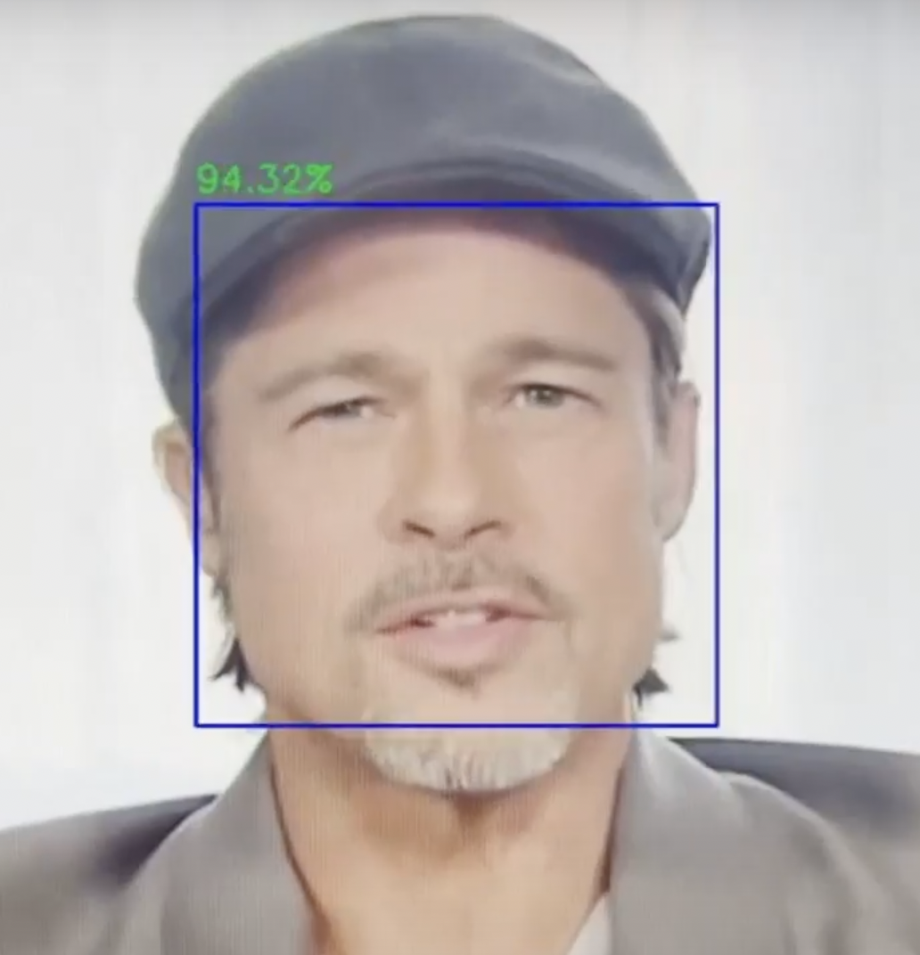
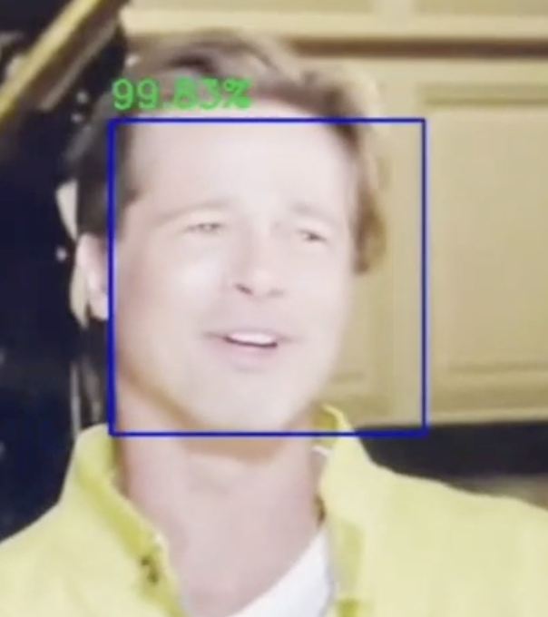
What Makes Our Project Unique?
Diverse Training Set - Images and video-images of Brad Pitt from different angles
Challenging Problem - Able to successfully detect Brad’s face amongst 5 individuals
Complex Methodology - Creating dataset, Drawing bounding box, Implementing VGG-16, etc.

Slide 13
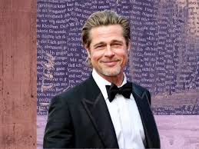
Thank You So Much!
We would like to thank our TA, Phillipe Do, and our Professor Jianbo Shi for all of their contributions in helping us gather the right knowledge and tools to successfully complete our final project in Computer Vision.

